Slide 1
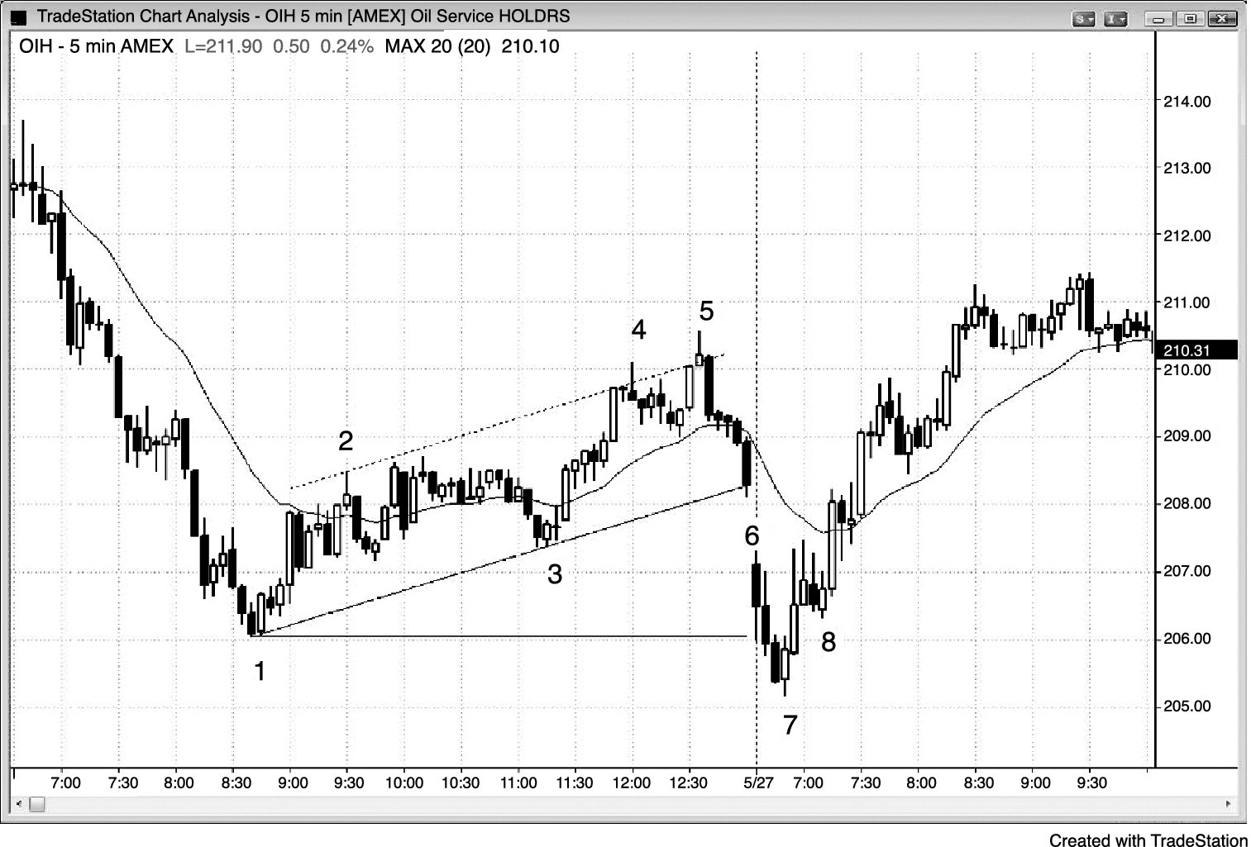
FIGURE 18.1 A Bull Channel Is a Bear Flag

Slide 2
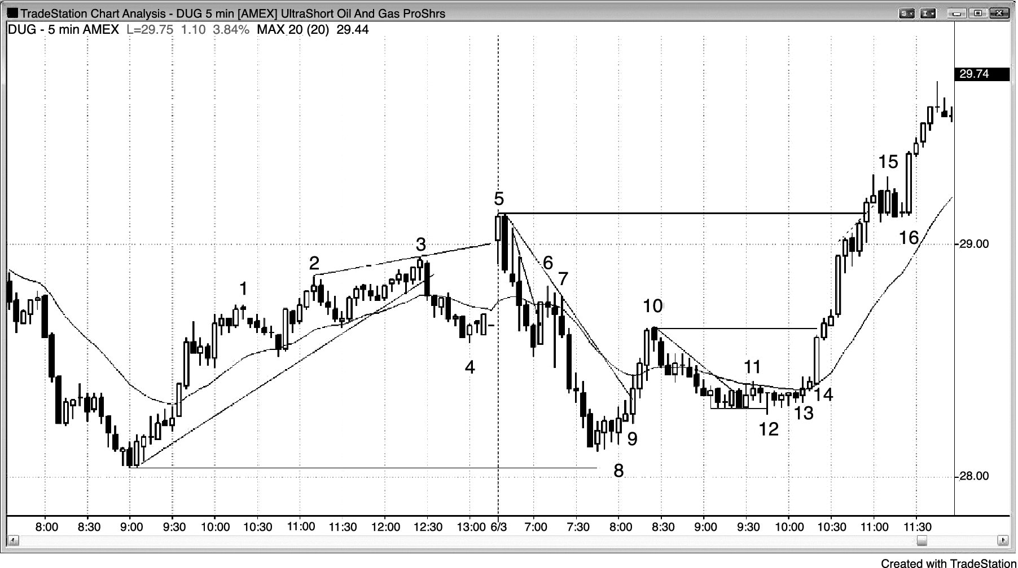
FIGURE 18.2 Failed Breakout Early in the Day

Slide 3
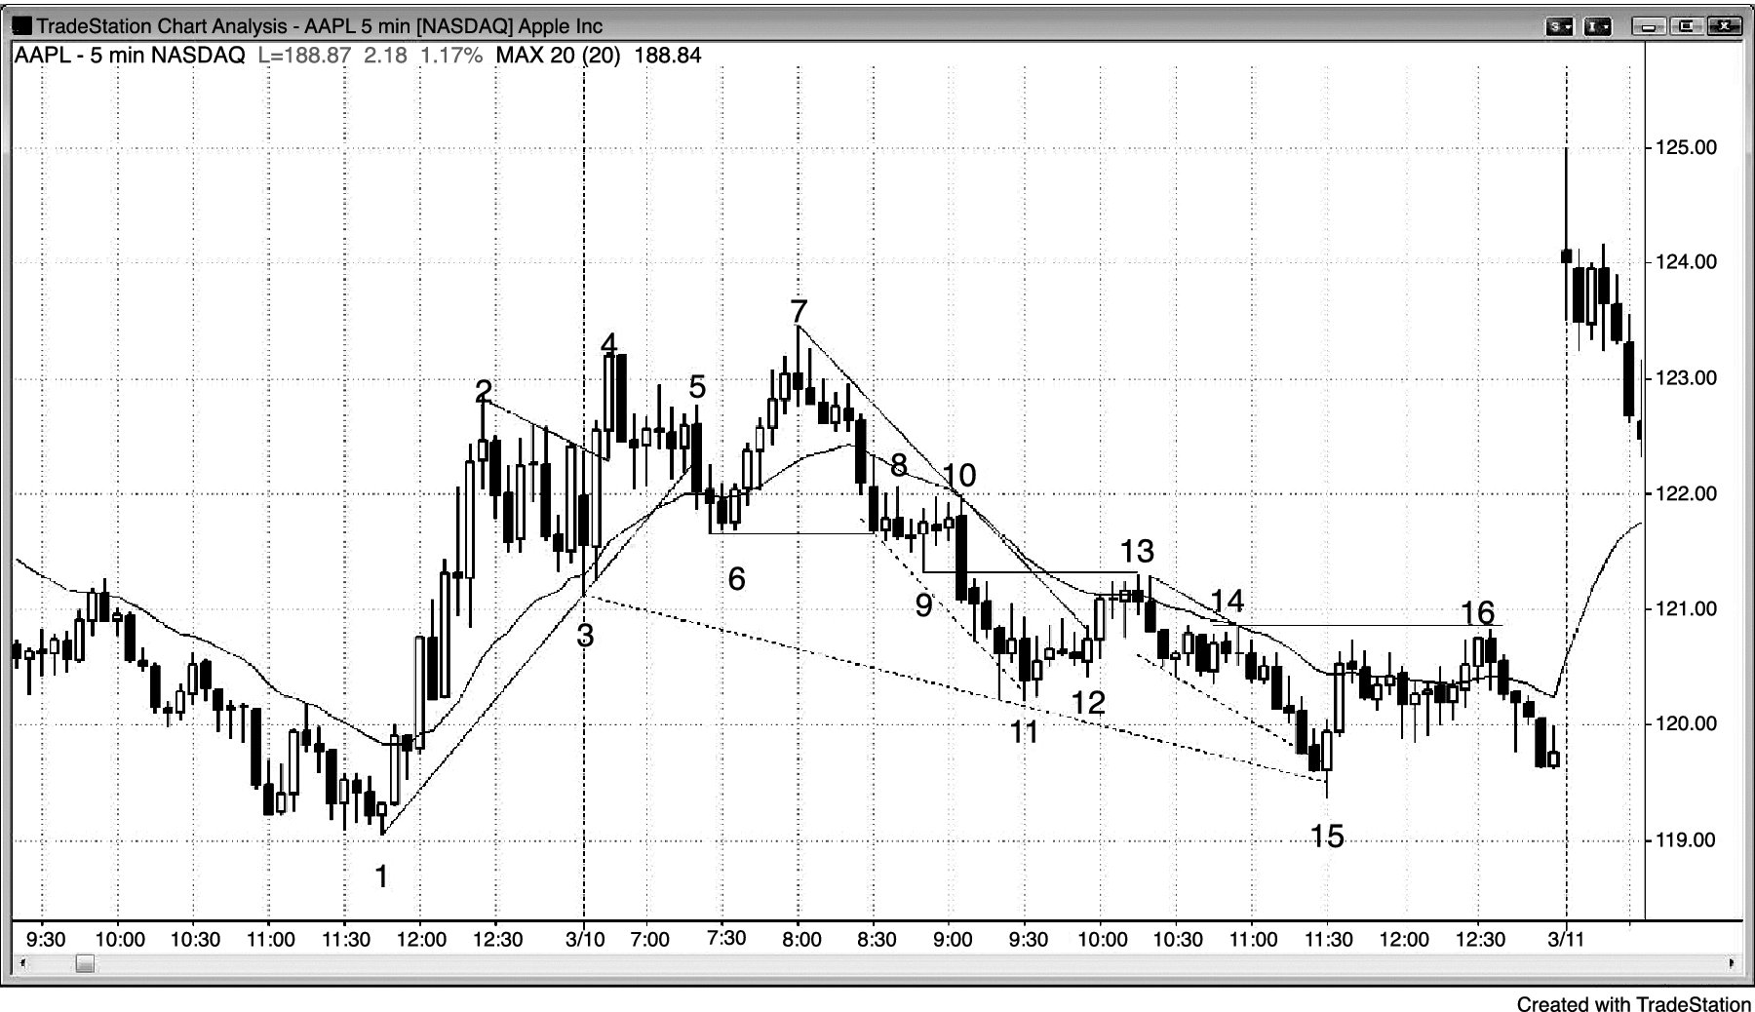
FIGURE 18.3 First-Hour Double Top

Slide 4
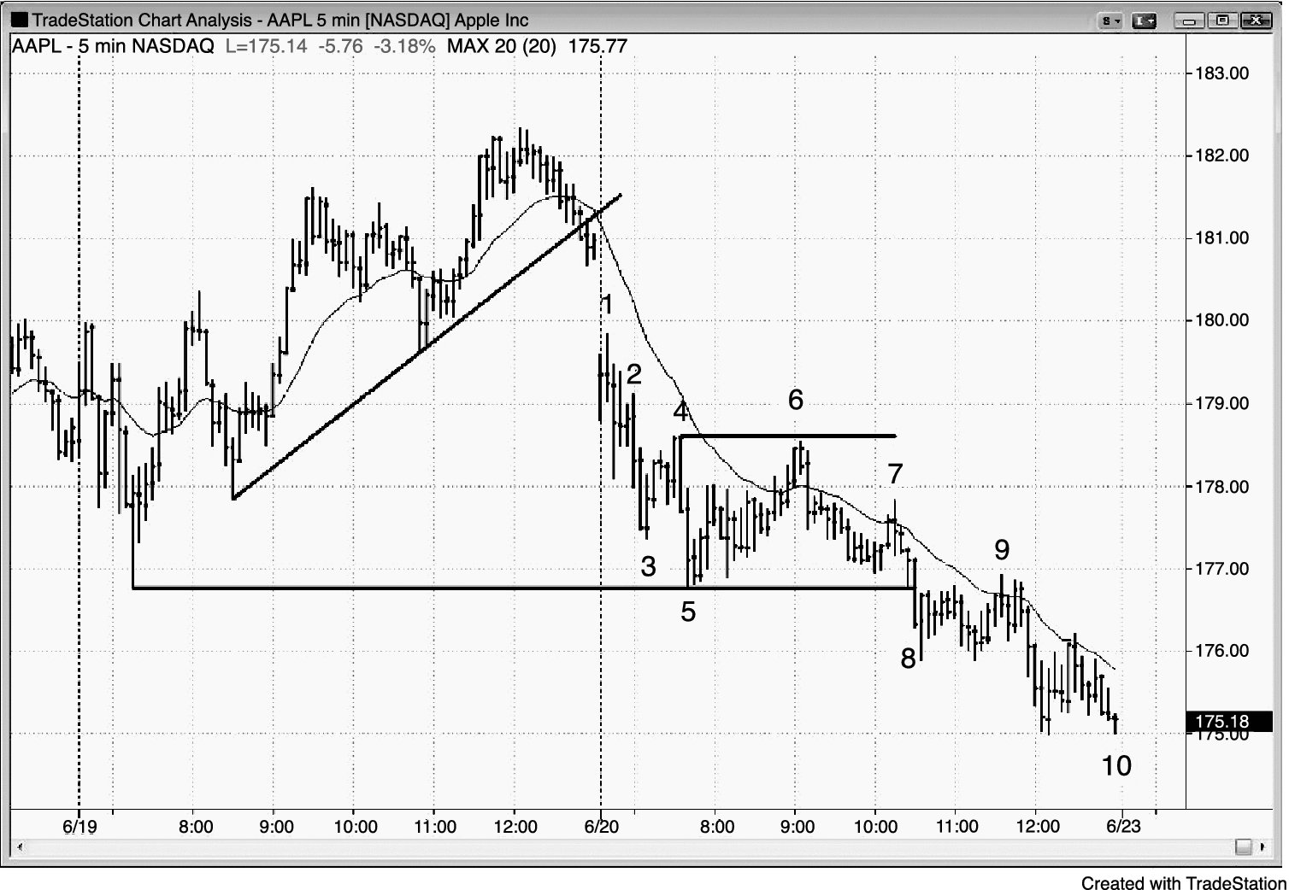
FIGURE 18.4 Breakout from Yesterday’s Pattern

Slide 5
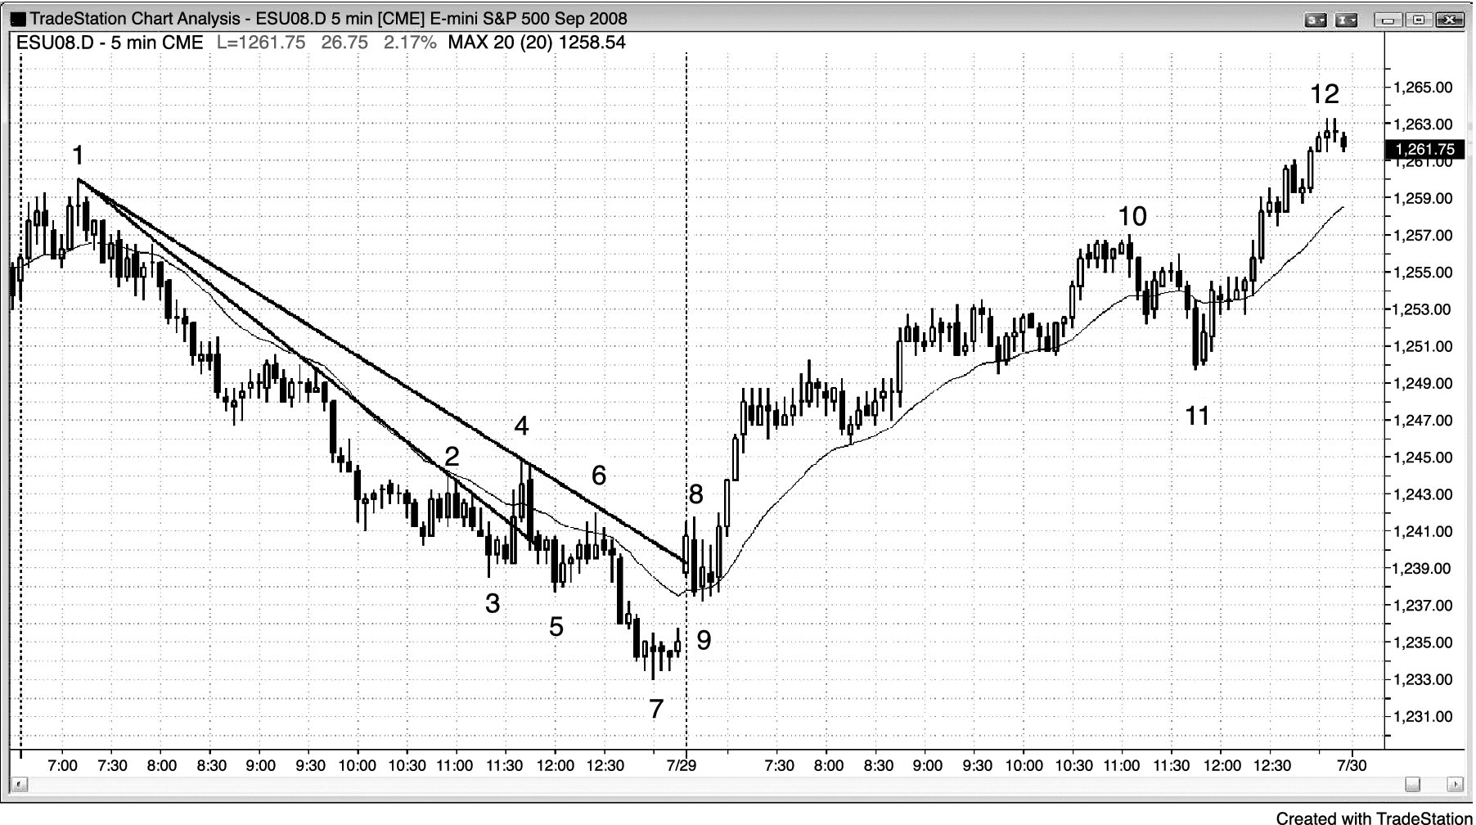
FIGURE 18.5 A Bear Channel Is a Bull Flag

Slide 6
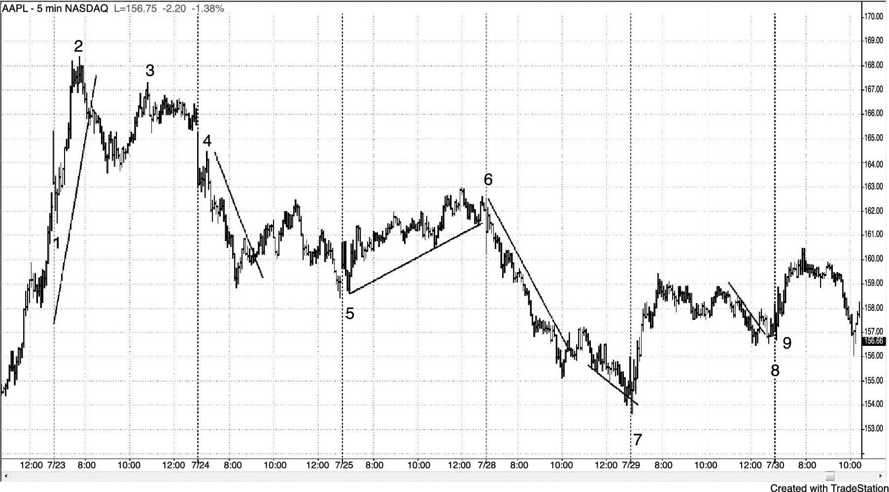
FIGURE 18.6 Yesterday’s Patterns Are Important

